Slide 1
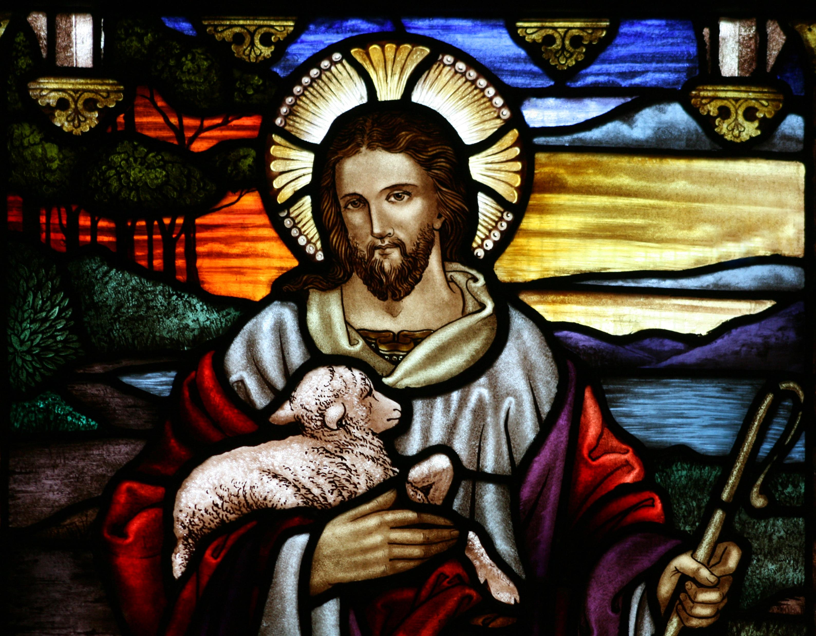
Who is Jesus—Part 5? Jesus is Our Only Hope.
John 1:19-37

Slide 2
John 1:35-37
³⁵ The next day again John was standing with two of his disciples, ³⁶ and he looked at Jesus as He walked by and said, “Behold, the Lamb of God!” ³⁷ The two disciples heard him say this, and they followed Jesus.

Slide 3
I. John the Baptist Gives His Testimony About Himself vv. 19-24.
¹⁹ And this is the testimony of John, when the Jews sent priests and Levites from Jerusalem to ask him, “Who are you?” ²⁰ He confessed, and did not deny, but confessed, “I am not the Christ.” ²¹ And they asked him, “What then? Are you Elijah?” He said, “I am not.” “Are you the Prophet?” And he answered, “No.”

Slide 4
I. John the Baptist Gives His Testimony About Himself vv. 19-24.
²² So they said to him, “Who are you? We need to give an answer to those who sent us. What do you say about yourself?” ²³ He said, “I am the voice of one crying out in the wilderness, ‘Make straight the way of the Lord,’ as the prophet Isaiah said.” ²⁴ (Now they had been sent from the Pharisees.)

Slide 5
I. John the Baptist Gives His Testimony About Himself vv. 19-24.
John’s preaching reminded people of their sin and called them to repent because God’s King was coming.
The people waited with hope for the Christ to arrive. John’s job was to serve God and man by helping us see the glory of Jesus Christ.
The heartbeat of faithful ministry is to serve God in a way that helps people see the glory of Christ.

Slide 6
II. John Explains the Significance of His Ministry vv. 25-28.
²⁵ They asked him, “Then why are you baptizing, if you are neither the Christ, nor Elijah, nor the Prophet?” ²⁶ John answered them, “I baptize with water, but among you stands one you do not know, ²⁷ even he who comes after me, the strap of whose sandal I am not worthy to untie.” ²⁸ These things took place in Bethany across the Jordan, where John was baptizing.

Slide 7
II. John Explains the Significance of His Ministry vv. 25-28.
“There is someone much greater than me who stands unnoticed among you. My job is to get people ready for the day He is revealed.”
Christian witness is pointing people to Jesus so that they might seek Him for salvation & find Him.
Let’s pray that Jesus’ presence would be powerfully felt in our midst so that people can see that Jesus is among us.

Slide 8
III. John the Baptist Reveals who Jesus is vv. 29-34, 35.
²⁹ The next day he saw Jesus coming toward him, and said, “Behold, the Lamb of God, who takes away the sin of the world! ³⁰ This is He of whom I said, ‘After me comes a Man who ranks before me, because He was before me.’

Slide 9
III. John the Baptist Reveals who Jesus is vv. 29-34, 35.
³¹ I myself did not know Him, but for this purpose I came baptizing with water, that He might be revealed to Israel.” ³² And John bore witness: “I saw the Spirit descend from heaven like a dove, and it remained on Him.

Slide 10
III. John the Baptist Reveals who Jesus is vv. 29-34, 35.
³³ I myself did not know Him, but He who sent me to baptize with water said to me, ‘He on whom you see the Spirit descend and remain, this is He who baptizes with the Holy Spirit.’ ³⁴ And I have seen and have borne witness that this is the Son of God.

Slide 11
III. John the Baptist Reveals who Jesus is vv. 29-34, 35.
John proclaimed Jesus the Lamb of God who takes away the sin of the world v. 30.
Jesus is the Lamb who would die once to pay for sins (Isaiah 53:7, 10).
Jesus appeared in this world to take away sin (1 John 3:5; Hebrews 10:4, 11).

Slide 12
Jesus Appeared in this World to Take Away Sin
1 John 3:5 You know that He appeared in order to take away sins, and in Him there is no sin.
Hebrews 10:4 For it is impossible for the blood of bulls and goats to take away sins.
Hebrews 10:11 And every priest stands daily at his service, offering repeatedly the same sacrifices, which can never take away sins.

Slide 13
Who is Jesus? He is our only hope.
Your sin has separated you from God, but through faith in Jesus Christ you can be forgiven and reconciled to God.
Jesus is your only hope.

