Slide 1
Who is Jesus (Part 3)? The Light in the Darkness
John 1:1-9

Slide 2
John 1:1-9
In the beginning was the Word, and the Word was with God, and the Word was God. ² He was in the beginning with God. ³ All things were made through Him, and without Him was not any thing made that was made.

Slide 3
John 1:1-9
⁴ In Him was life, and the life was the light of men. ⁵ The light shines in the darkness, and the darkness has not overcome it.

Slide 4
John 1:1-9
⁶ There was a man sent from God, whose name was John. ⁷ He came as a witness, to bear witness about the light, that all might believe through him.

Slide 5
John 1:1-9
⁸ He was not the light, but came to bear witness about the light. ⁹ The true light, which gives light to everyone, was coming into the world.

Slide 6
I. Jesus is the Creator of Natural Life & Light v. 1-4.
Jesus is the agent of creation (Gen 1:1-3; John 1:3; Colossians 1:15-20; Hebrews 1:1-2).
God the Father sent His Only Begotten Son into this dark, sin sick world, to speak to us and reconcile us to the Father.

Slide 7
II. Jesus Our creator Came to Give us Eternal Life v 4.
In Him was life, and the life was the light of men.
Jesus was and is the source of both natural and spiritual life.
Jesus came to people who are dead in their trespasses and sins so that we might have eternal life (Ephesians 2:1-10).

Slide 8
III. Jesus the Creator Came to Give us Spiritual Life v. 4, 5.
⁴ In Him was life, and the life was the light of men. ⁵ The light shines in the darkness, and the darkness has not overcome it.

Slide 9
Rejecting the light of Jesus brings condemnation but believing in Him brings eternal life (John 3:16-19).
¹⁶ “For God so loved the world, that He gave his only Son, that whoever believes in Him should not perish but have eternal life. ¹⁷ For God did not send his Son into the world to condemn the world, but in order that the world might be saved through him.

Slide 10
Rejecting the light of Jesus brings condemnation but believing in Him brings eternal life (John 3:16-19).
¹⁸ Whoever believes in Him is not condemned, but whoever does not believe is condemned already, because he has not believed in the name of the only Son of God.

Slide 11
¹⁹ And this is the judgment: the light has come into the world, and people loved the darkness rather than the light because their works were evil.

Slide 12
Some prefer to walk in darkness rather than light because their deeds are evil (John 3:20-21).
²⁰ For everyone who does wicked things hates the light and does not come to the light, lest his works should be exposed. ²¹ But whoever does what is true comes to the light, so that it may be clearly seen that his works have been carried out in God.”

Slide 13
IV. Jesus Gives Eternal Life to Those Who Believe in Him vv. 6-9.
⁶ There was a man sent from God, whose name was John. ⁷ He came as a witness, to bear witness about the light, that all might believe through him. ⁸ He was not the light, but came to bear witness about the light. ⁹ The true light, which gives light to everyone, was coming into the world.

Slide 14
IV. Jesus Gives Eternal Life to Those Who Believe in Him vv. 6-9.
John the Baptist was a prophet sent to witness to Jesus (Jn 1:33-34; 3:26-38; Acts 19:4-6).
John the Baptist was sent to shine the light of truth on people so that they would repent of their sin & believe in Jesus (v. 7).
Jesus still gives eternal life to those who believe in Him (John 3:16; Eph. 2:8).

Slide 15
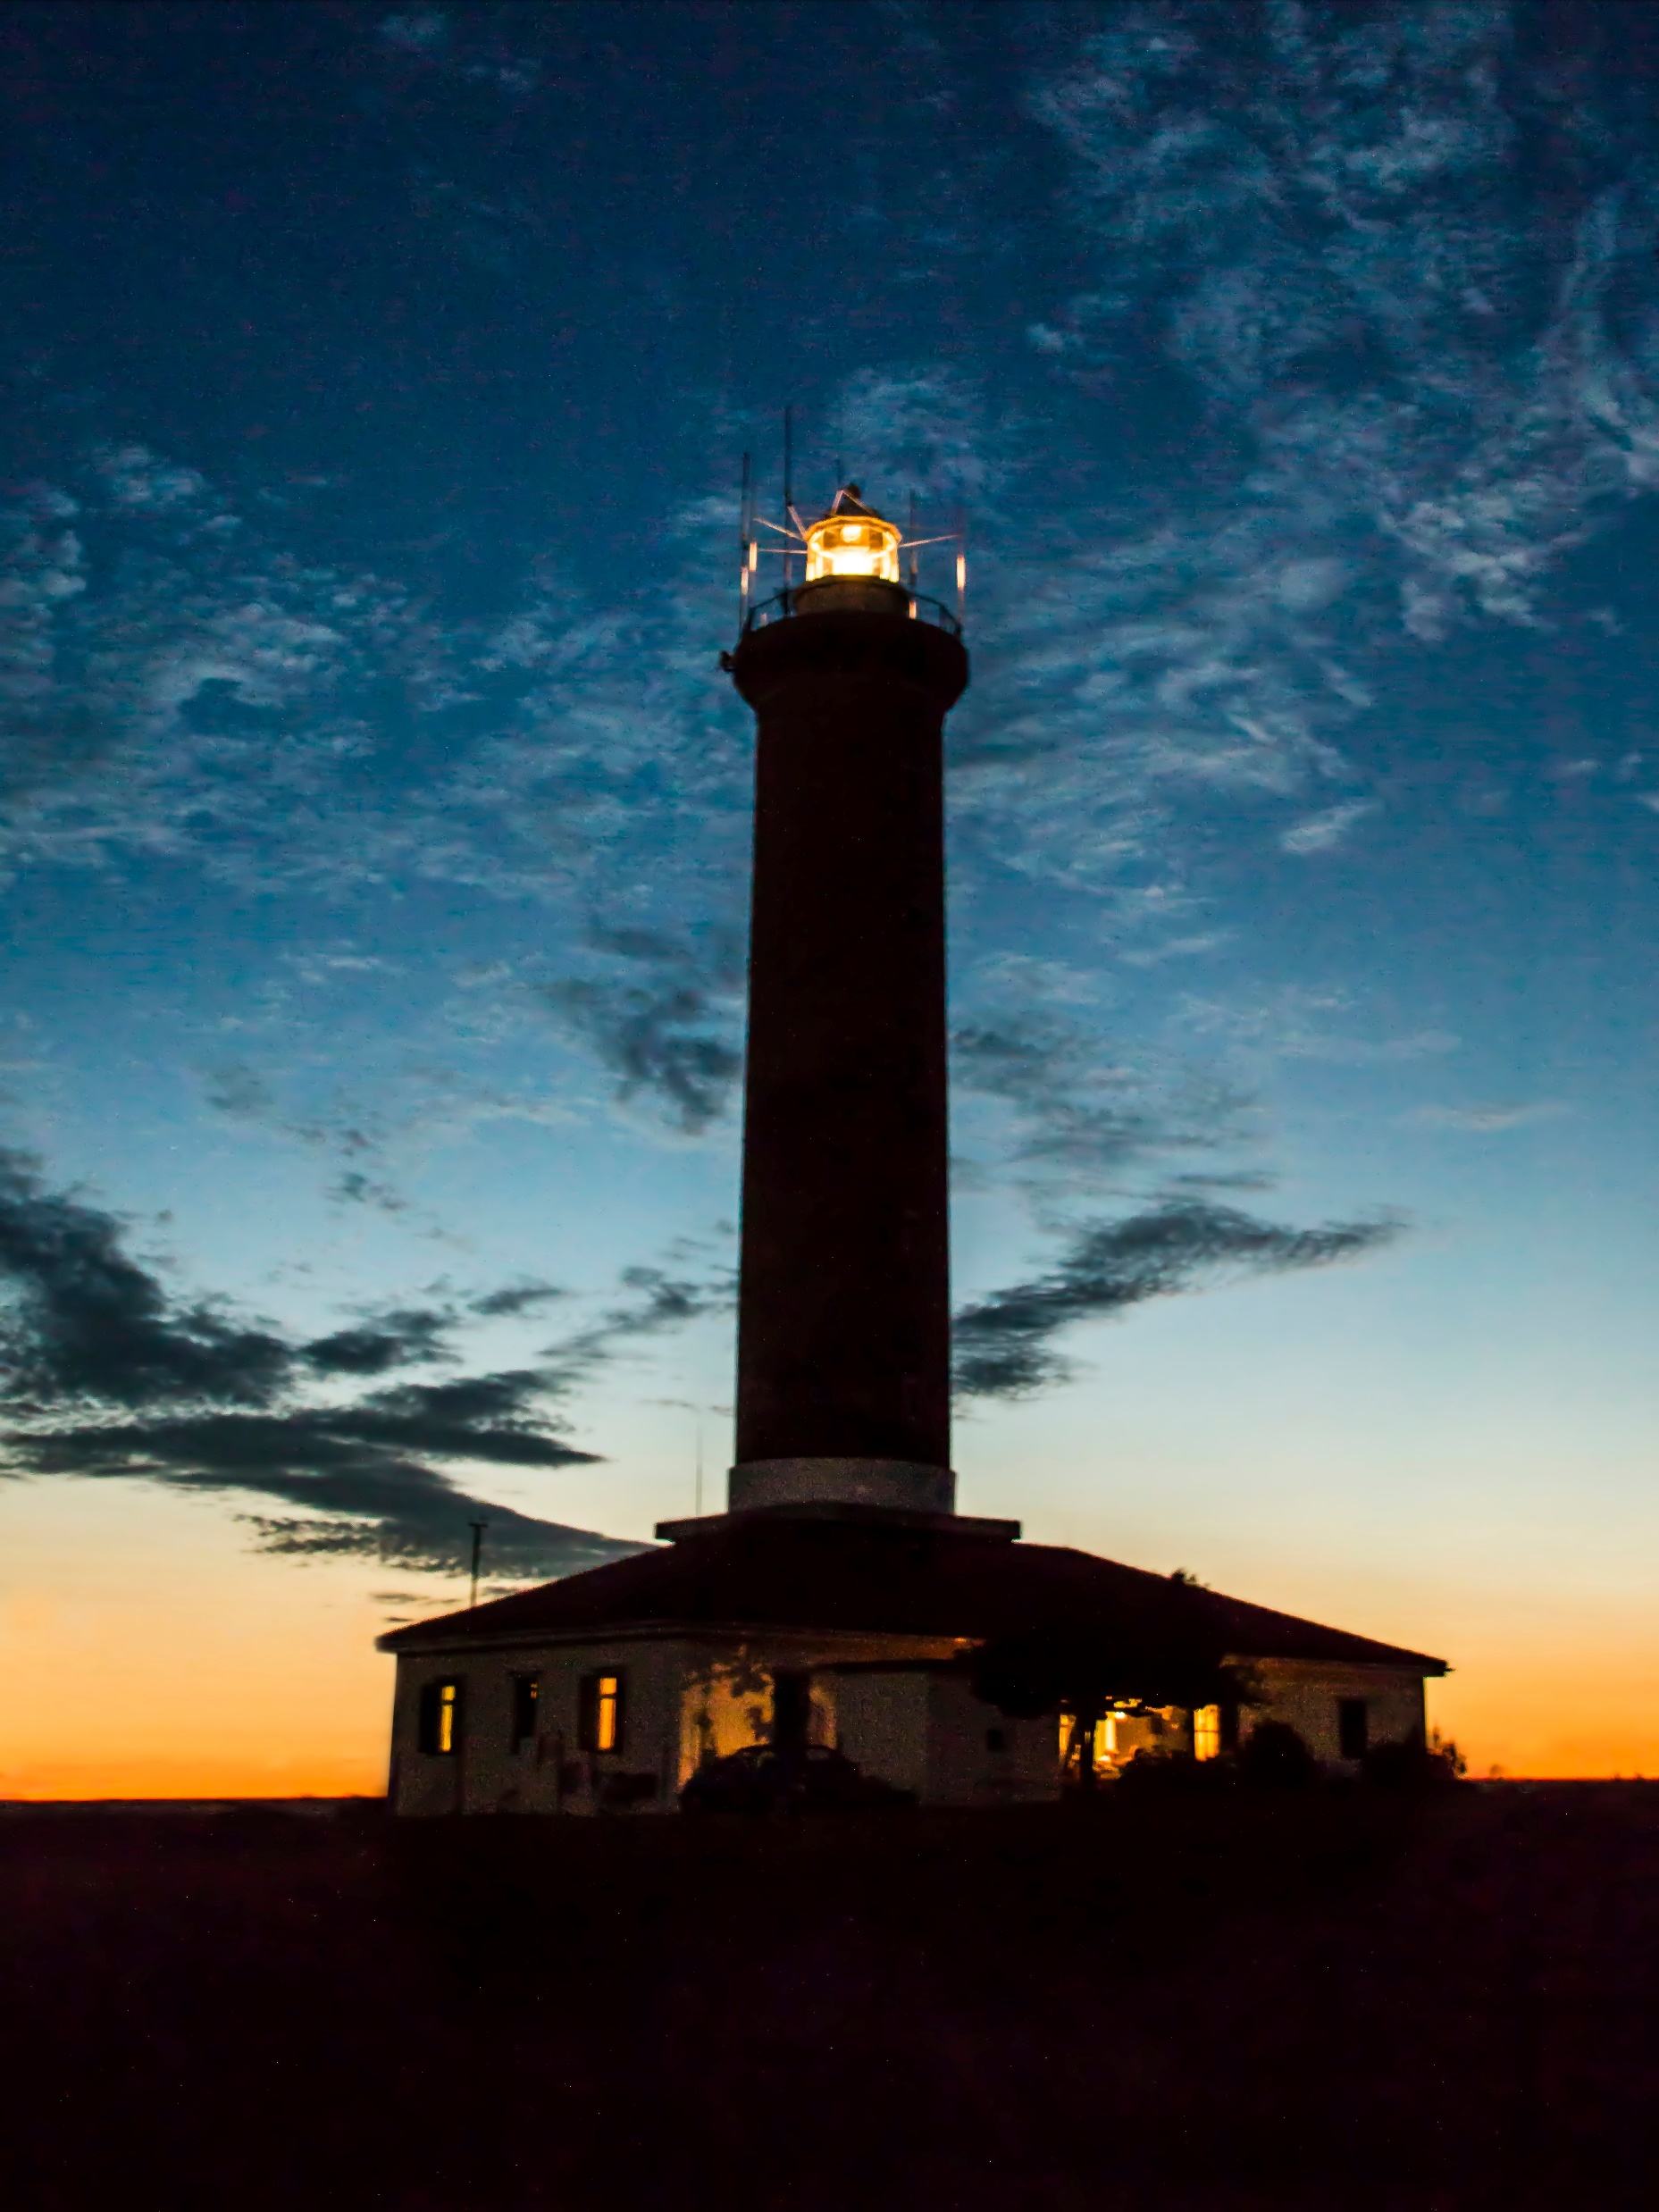
V. Jesus Alone Gives Spiritual Life to those Who believe in Him vv. 6-9.
Jesus alone is true light.
Jesus still gives spiritual life to those who believe in Him.

